Slide 1
Design Patterns
Decorator Pattern

Slide 2
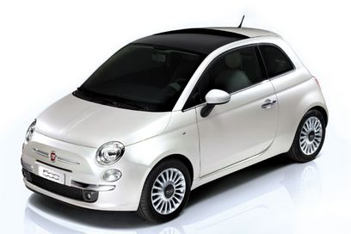
My Car
Here’s a picture of my car

Slide 3
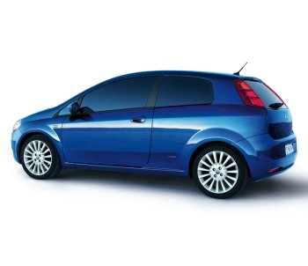
Other Fiat Cars
Some people prefer the Fiat Punto

Slide 4
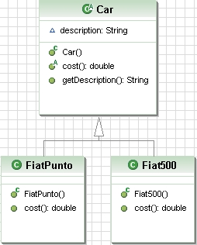
Let’s Use Inheritance
The method cost is abstract to force concrete implementation

Slide 5
Accessories
When you order these cars you can decorate them with accessories

Slide 6
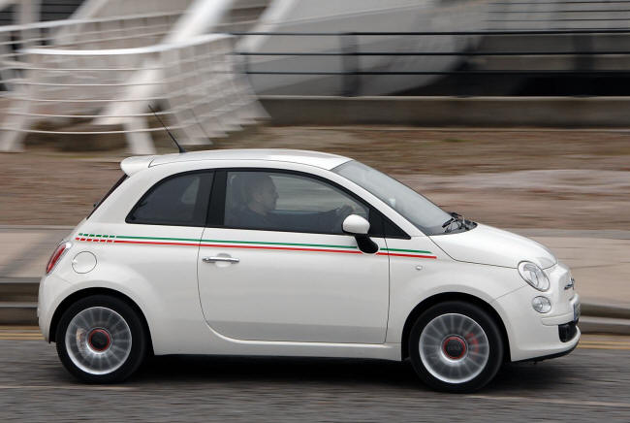
Accessories
Go faster stripe

Slide 7
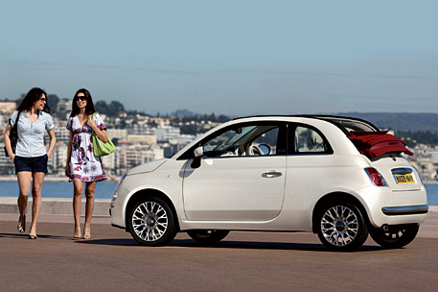

Accessories
Sunroof
Concentrate on the sunroof

Slide 8
Too Many Cars
With just two cars and two accessories we now have 8 possible combinations

Slide 9
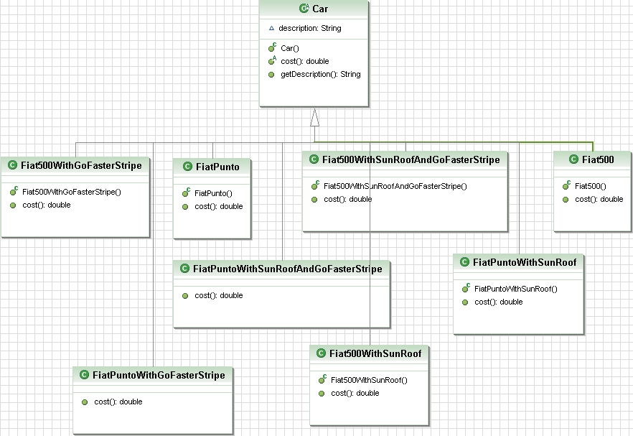
Using Inheritance ...

Slide 10
An Alternative Approach
Use instance variables to keep track of the accessories

Slide 11
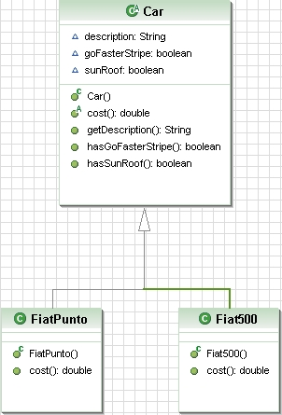
An Alternative Approach

Slide 12
Cost
We calculate the cost in two parts
In the class car
public double cost() {
  double cost = 0.0;
if(hasSunRoof()) {
cost = cost + 500.0;
}
if(hasGoFasterStripe()) {
cost = cost + 50.0;
}
return cost;
}

Slide 13
Cost
And in the subclasses of car
public double cost() {
return 12000.07 + super.cost();
}

Slide 14
Problems with this technique
Price changes for accessories force us to alter code
New accessories means we have to change the cost method in Car
We may add new cars and inherit inappropriate accessories

Slide 15
Design Principle
Classes should be open for extension but closed for modification

Slide 16
Decorator Pattern
Demo Time

Slide 17
Patterns
That is the Decorator Pattern

